Slide 1
Employee Attrition Analysis & Prediction Using Machine Learning
Tools:
Python (Pandas, Scikit-learn), Power BI, DAX
Blesson Biju
UMID – UMID27112571779
Dec 1st Batch

Slide 2
Business Problem
Problem Statement:
  Employee attrition increases hiring and training costs.
  Identifying employees at risk can help HR take preventive actions.
Objective:
  Analyze factors affecting attrition.
  Build a machine learning model to predict attrition.
  Create an interactive Power BI dashboard for HR insights.

Slide 3
Dataset & Features
Total Records: 1470
Features: 35
Target Variable: Attrition (Yes/No)
16% employees left
84% stayed

Slide 4
Data Preprocessing & EDA
Preprocessing:
  Removed irrelevant columns (EmployeeNumber, EmployeeCount, etc.)
  Encoded categorical variables
  Handled class imbalance
  Train-test split
Key Insights from EDA:
  Employees working overtime have higher attrition
  Lower income correlates with higher attrition
  Early-career employees are more likely to leave

Slide 5
Feature Importance
Top Contributing Features:
  OverTime
  MonthlyIncome
  JobRole
  YearsAtCompany
  JobSatisfaction

Slide 6
Interactive HR Dashboard (Power BI)
Attrition rate by Department
Overtime vs Attrition
Income distribution
Job Role vs Attrition
Filters for HR analysis

Slide 7
Conclusion
Key Findings:
  Overtime strongly increases attrition risk
  Lower income employees show higher turnover
  Early-career employees are more likely to leave
Recommendations:
  Improve work-life balance policies
  Review compensation for high-risk roles
  Implement retention programs for new employees
Predictive analytics enables proactive employee retention strategies.

Slide 8
Tools & Technologies
Python (Pandas, NumPy, Scikit-learn)
Power BI & DAX
CSV-based analytics dataset
Jupyter Notebook

Slide 9
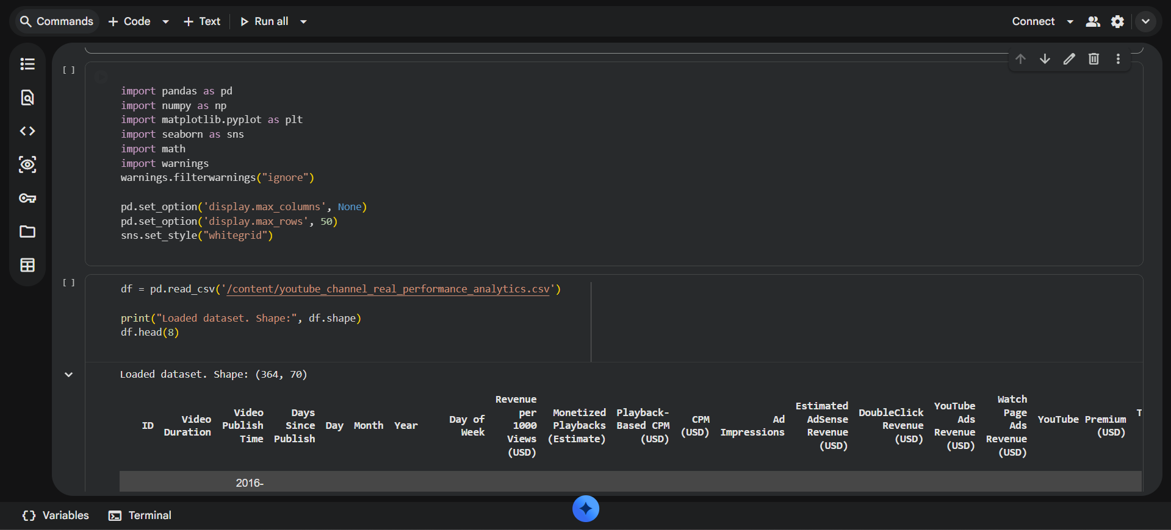

Slide 10
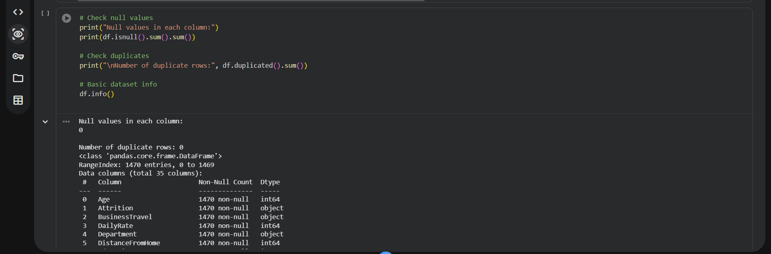
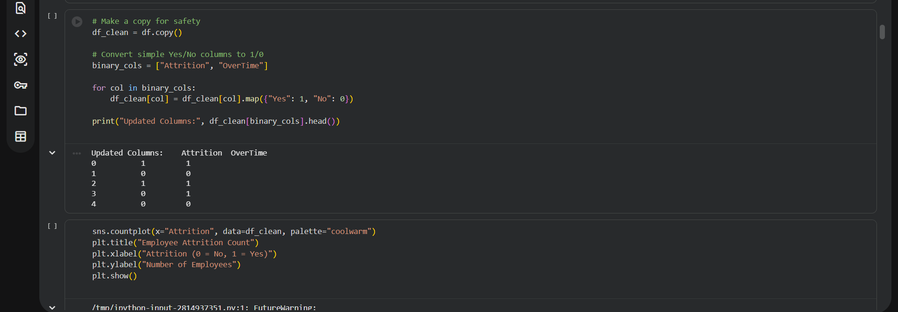

Slide 11
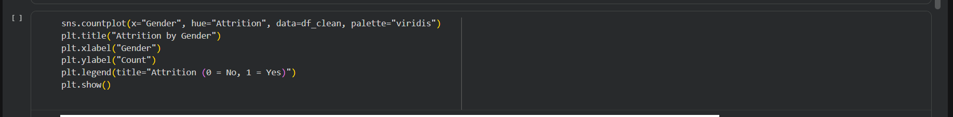
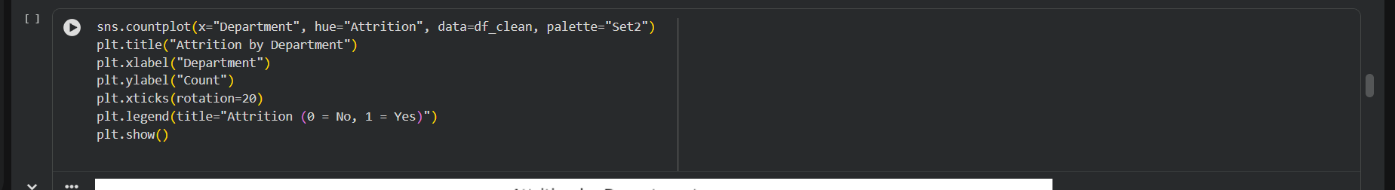
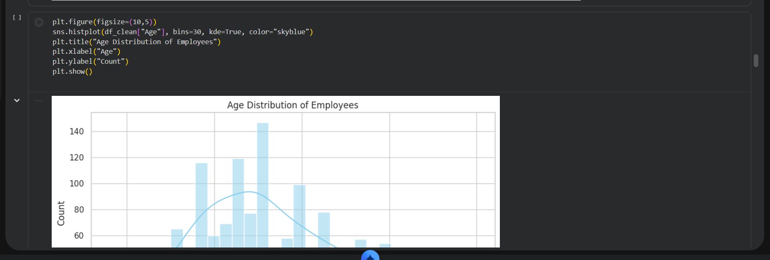

Slide 12
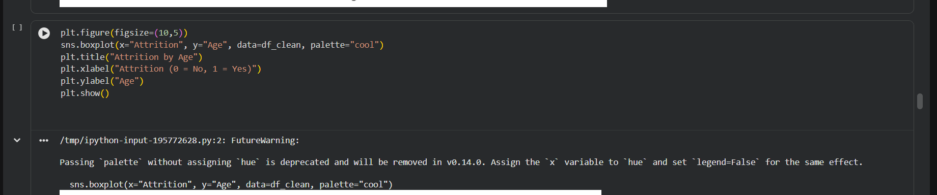
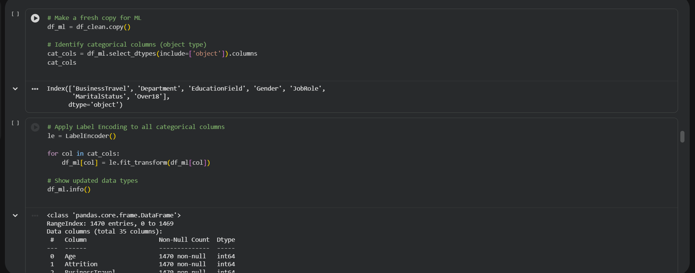

Slide 13
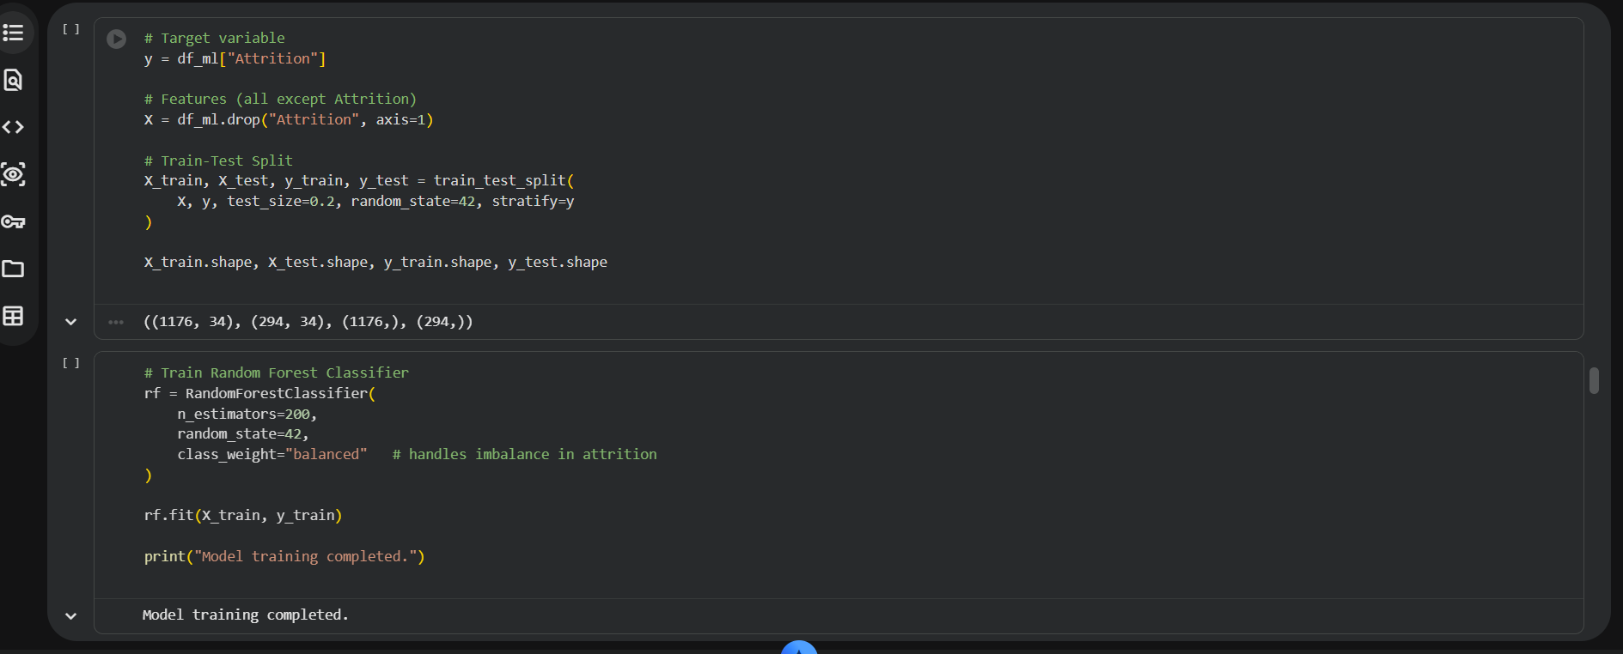
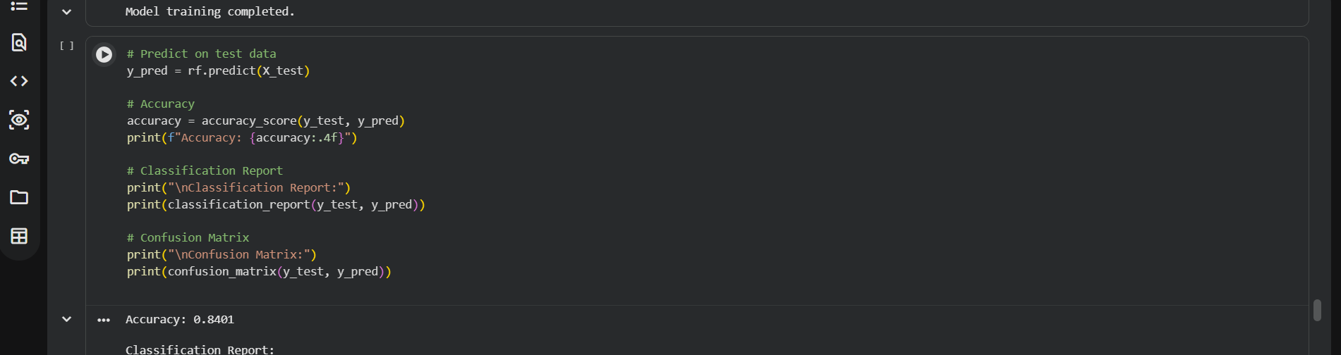

Slide 14
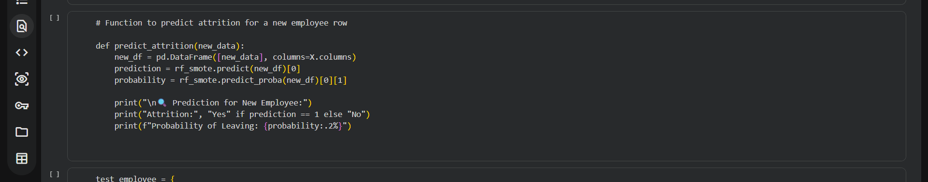
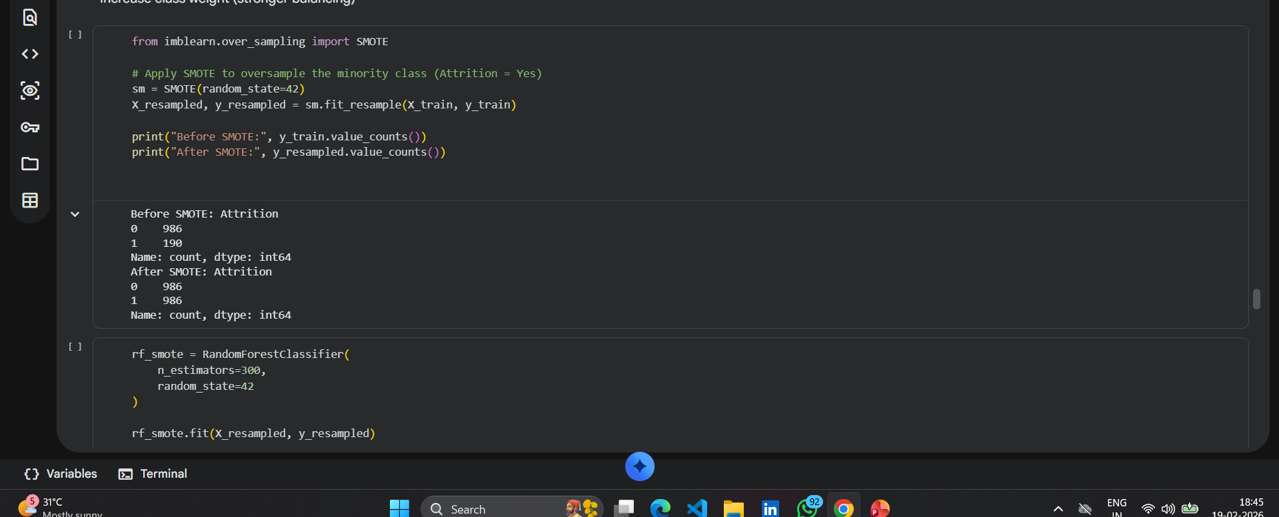

Slide 15
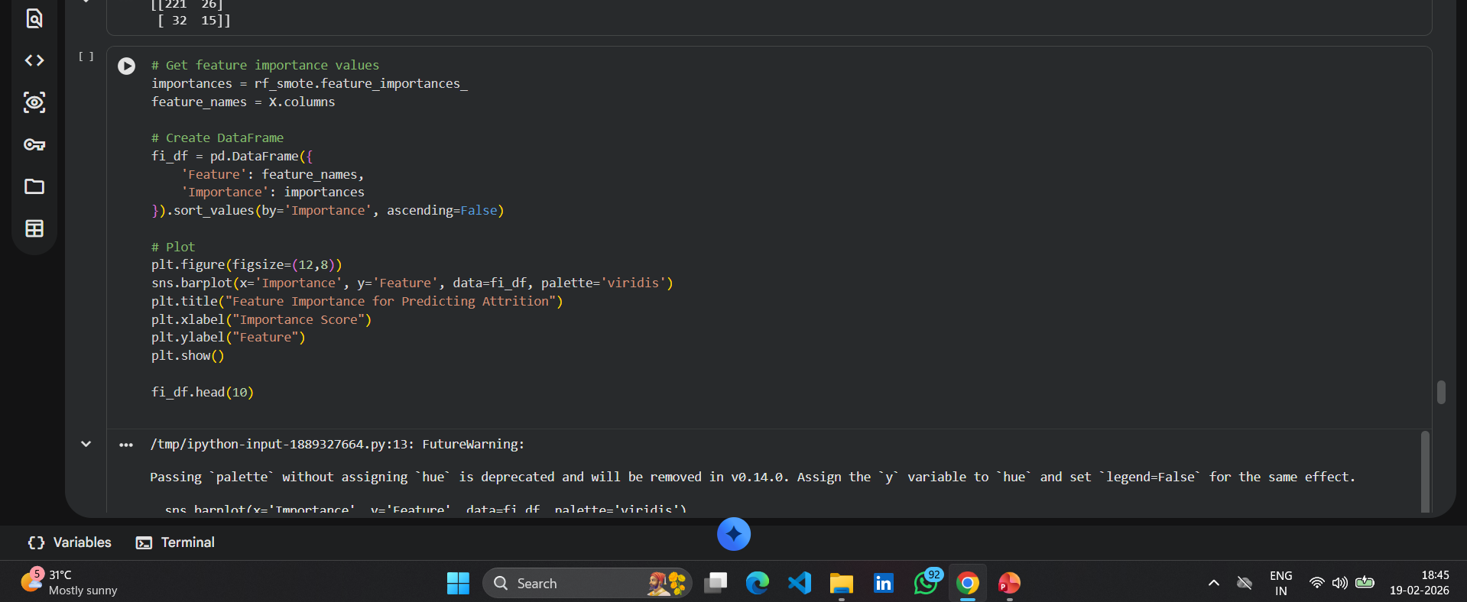

Slide 16
